Slide 1
Web Information System
Truong Thi Dieu Linh, PhD
Nguyen Hong Phuong, Msc.

Slide 2
Objectives
Provide students with theory and concept about web information system from the past to future:
  Basic concepts of Internet, WWW
  Fundamental knowledge of HTML, CSS: elements of static web pages
  Client-side and server-side dynamic web pages: concepts and development
  Issues on web information systems: service containers, security, scalability
  Advanced topic: web services, web 2.0, web 3.0.

Slide 3
Course Plan
1st week: Introduction
2nd week: HTTP
3rd week: HTML
4th week: CSS
5th week: Overview of dynamic page
6th week: Client side dynamic page
7th week: Server side dynamic page
8th week: Service container
9th week: Security
10th week: Scalability
11th week: Advanced topic – Web service, XHTML
12th week: Advanced topic - Web 2.0
13th week: Advanced topic – Web 3.0
14th,15th weeks: Groups of 4 students present different topics given by professors

Slide 4
Evaluation
Midterm test 30%
Topic presentation 70%

Slide 5
Working method
Study student lecture note
Ask professor questions in the class
Search for solutions in web or discuss with classmates
Contact with professor
  9:00 – 10:00 Mondays.
  Department of Communication and Computer Networks – SoICT, C1 - 329
  ĐT: 8680896
  Mail: linhtd@it-hut.edu.vn
  Slides and lecture note can be found at
www.it-hut.edu.vn/~linhtd

Slide 6
References
Student lecture note of the course Web Information System
Website:
  http://www.w3schools.com/
  http://www.w3.org/TR/
  http://www.w3.org/2001/sw/
  http://www.ibm.com/developerworks/web/
  http://java.sun.com/
  http://www.apache.org/

Slide 7
Chapter 1: Introduction
Brief history of Internet
What is not a Web system
Typical application
Social impact

Slide 8
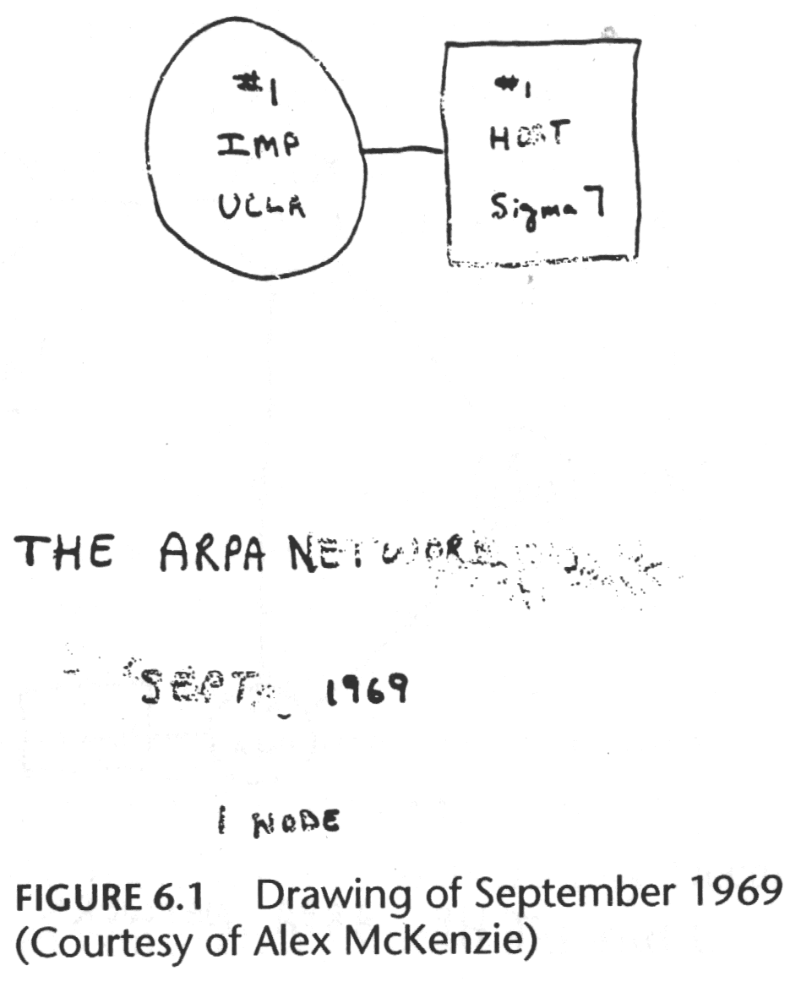
History of Internet
ARPRANET was born with a project of ARPA
At the beginning, there is only a link between two nodes (IMP of UCLA and IMP of SRI).
ARPA: Advanced Research Project Agency
UCLA: University California Los Angeles
SRI: Stanford Research Institute
IMP: Interface Message Processor
Source: http://www.cybergeography.org/atlas/historical.html

Slide 9
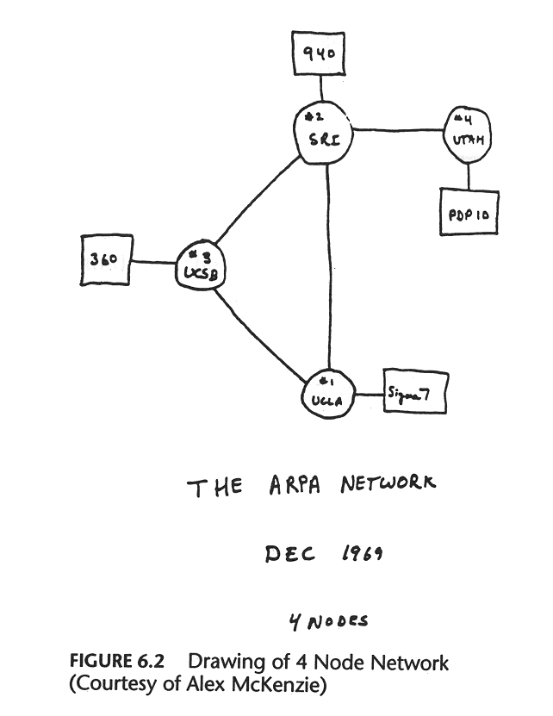
3 months later, 12/1969
SRI
UTAH
UCSB
UCLA
A network with 4 nodes, speed 56kbps
UCSB:University of California, Santa Barbara
UTAH:University of Utah
source: http://www.cybergeography.org/atlas/historical.html

Slide 10
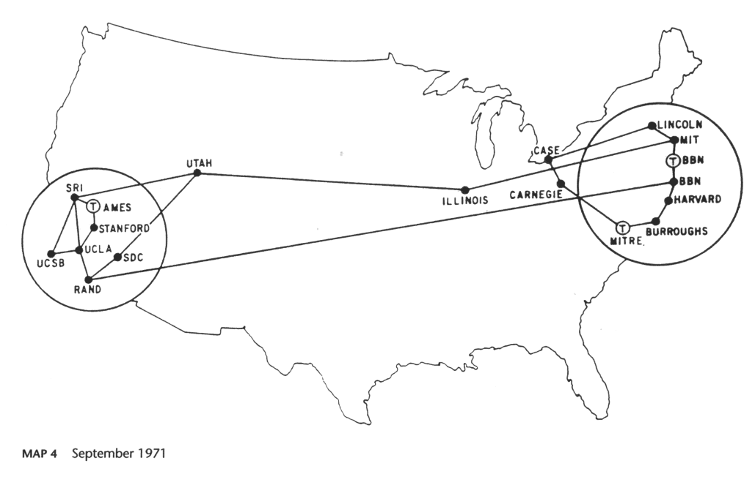
ARPANET at the beginning,1971
Source:
http://www.cybergeography.org/
atlas/historical.html
Growth speed: One additional node/month

Slide 11
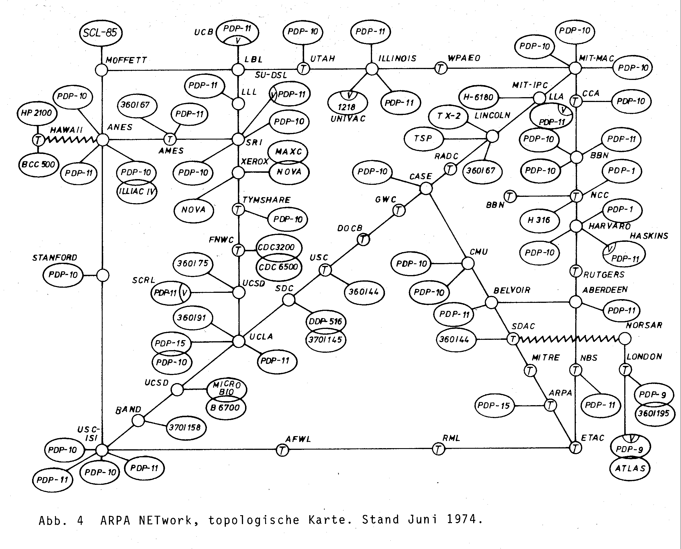
Expansion of ARPANET, 1974
source:
http://www.cybergeography.org/
atlas/historical.html
Traffic: 3.000.000 packets/day

Slide 12
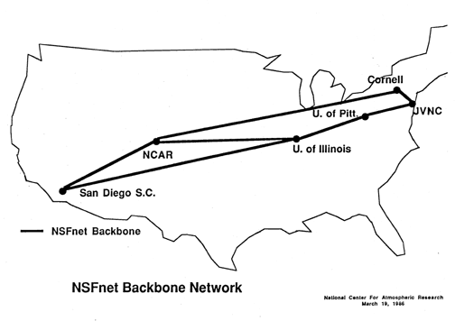
1981: NSFNET is built
NSF: National Science Foundation
NSF is built for scientific research objectives due to the overload of ARPANET

Slide 13
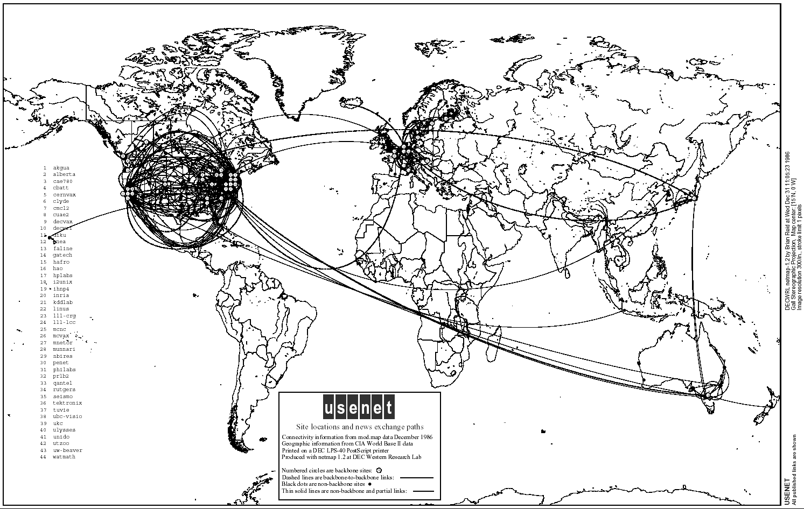
1986: Connections of USENET& NSFNET
Source: http://www.cybergeography.org/atlas/historical.html

Slide 14
90 Decade
Early 90s decade: Web presents
  HTML, HTTP: Berners-Lee
  1994: Mosaic, Netscape
Late 90s: Commercialize Internet
Late 1990’s – 2000’s:
New type of applications: chat, file sharing P2P…
E-commerce, Yahoo, Amazon, Google…
> 50 million station,
> 100 million users
Security issue!
  Everyone can use Internet
  Every application, services have to take into consider this issue

Slide 15
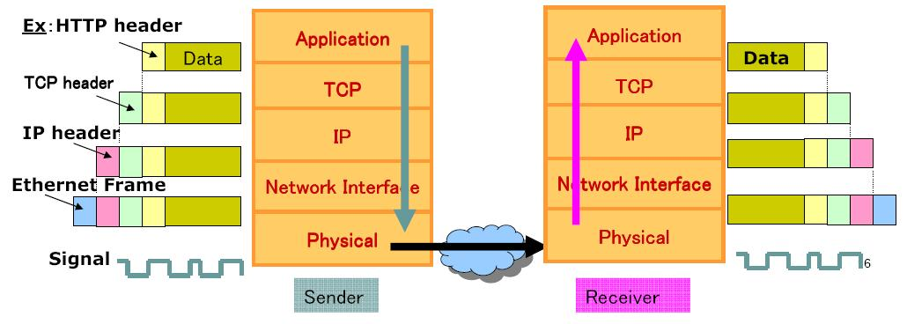
Internet protocol stack

Slide 16
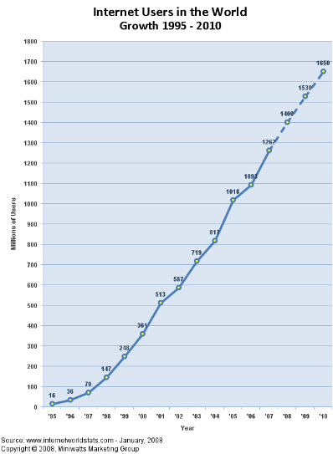
Statistics number

Slide 17
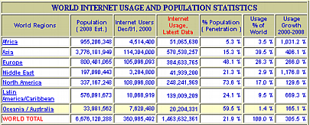
Statistics number

Slide 18
Development of Internet in Việt Nam
1996: Infrastructure for the Internet is ready
  ISP: VNPT
  one connection to international network of 64kbps,
1997: Việt Nam connects officially to the Internet
  1 IXP: VNPT
  4 ISP: VNPT, Netnam (IOT), FPT, SPT
2007:
  20 ISPs, 4 IXPs
  19 millions users, 22.04% population

Slide 19
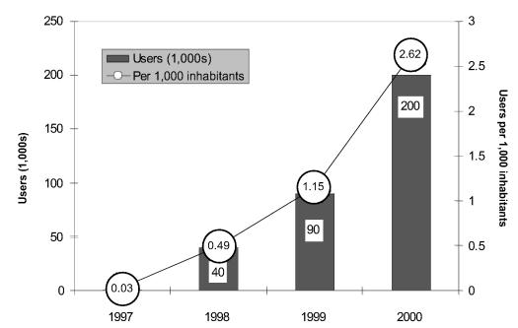
Development of Internet in VN
The number of users are estimated by twice the number of subscribers
Source: Vietnam Internet Case Study, http://www.itu.int/asean2001/reports/material/VNM%20CS.pdf

Slide 20
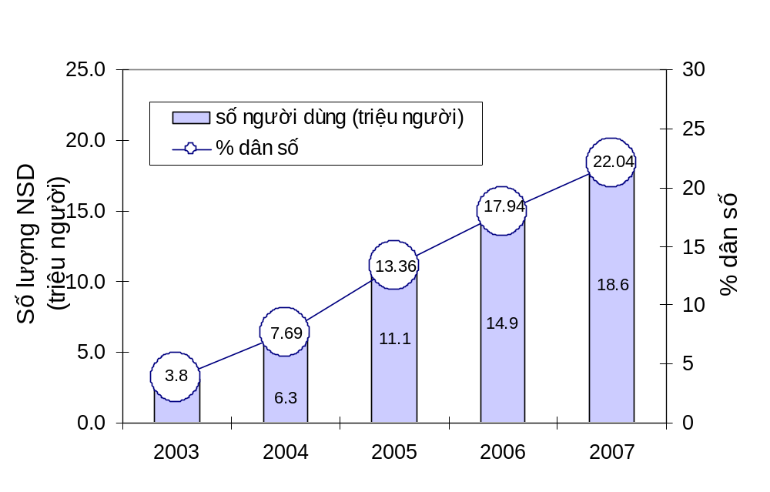
Recent statistics
Source: Vnnic, http://www.thongkeinternet.vn

Slide 21
Internet in 20xx
New applications and technologies
  Youtube, Skype, Bittorrent, Video & VoIP...
  Wireless networks, optical networks, mobile networks
  ….
Internet improve services and change continuously
  Objective is the convenience of users

Slide 22
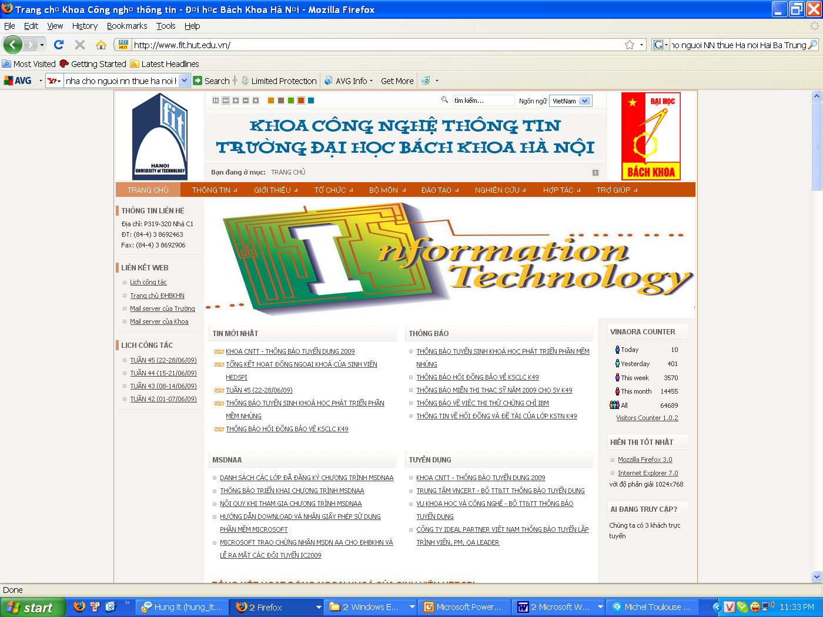
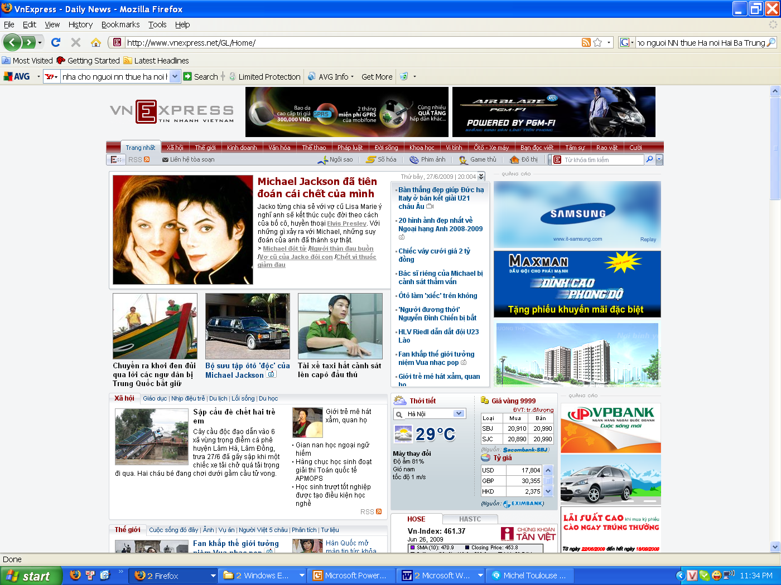
Definition of Web
The World Wide Web (Web in abbreviation) is a system of interlinked hypertext documents accessed via the Internet.
  Document may contain text, images, videos, and other multimedia
  With web browser, users can navigate between them using hyperlinks.

Slide 23
History of World Wide Web
Web is invented by English physicist Tim Berners-Lee:
  1989: Write a proposal "a large hypertext database with typed links"
  1990: build all the tools necessary for a working Web:
    Hypertext Transfer Protocol (HTTP) 0.9,
    HyperText Markup Language (HTML),
    WorldWideWeb: The first Web browser + editor for NeXT computer
    The first HTTP server software (later known as CERN http)

Slide 24
History of World Wide Web
1992-1995: Growth of the WWW
  1992 some web browsers was developed for X Window System for Linux: Erwise, ViolaWWW
  Feb. 1993: Mosaic web browser was created for X windows browser. It becomes Netscape when it is commercialized in 1994
  June 1993: Cello, the first Microsoft Windows browser was created.
Timeline of web browsers:
http://en.wikipedia.org/wiki/Timeline_of_web_browsers

Slide 25
History of World Wide Web
Sept. 1994, Berners-Lee founded the World Wide Web Consortium (W3C) at the MIT with support from the DARPA and the European Commission.
  Objective: create standards and recommendations to improve the quality of the Web.
  W3C comprised various companies
  Web available freely, with no patent and no royalties due.
1996-1998: Commercialization of the WWW
  E-comerce: Web based commerce
  Dotcom compagnie display products on Web.
1999-2001: "Dot-com" boom and bust
2002-Present: The Web becomes ubiquitous

Slide 26
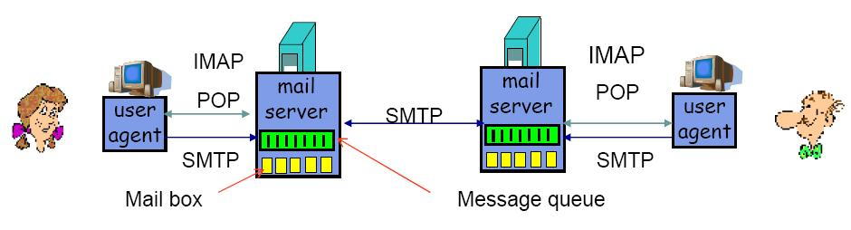
What is NOT a web system
Email
However many email systems provide Web interface for user to read and write email (web based user agent)
  Gmail, Hotmail, Yahoo, HUT’s email …

Slide 27
What is NOT a web system
Many internet services require dedicated client software to install. By using the Web as a platform for these services, users only need a web browser which is already installed in almost all client
computers nowadays.
Demerits of using web browsers for various services are restricted user interface, lack of local storage, and poor efficiency.
In many organizations, only designated communication between inside and outside is permitted for security reason.
  For example, if SMTP and POP are blocked by a firewall, users cannot access outside mail servers. Since HTTP is often permitted due to popularity of the Web system, users may well be able to access outside web mail systems.

Slide 28
What is NOT a web system
Example 2

Slide 29
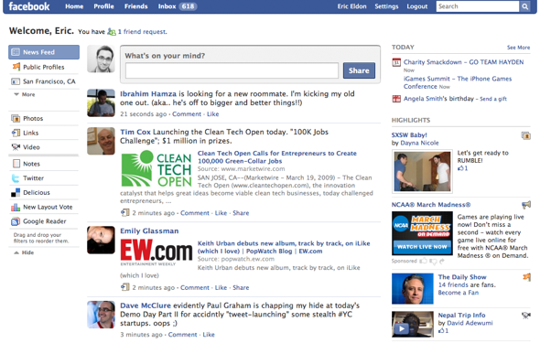
Typical applications
Blog

Slide 30
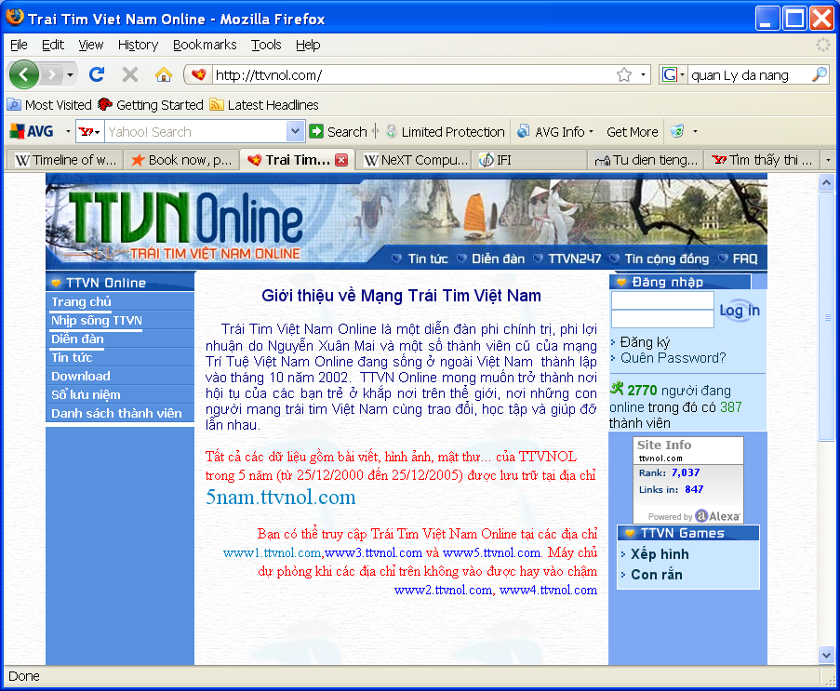
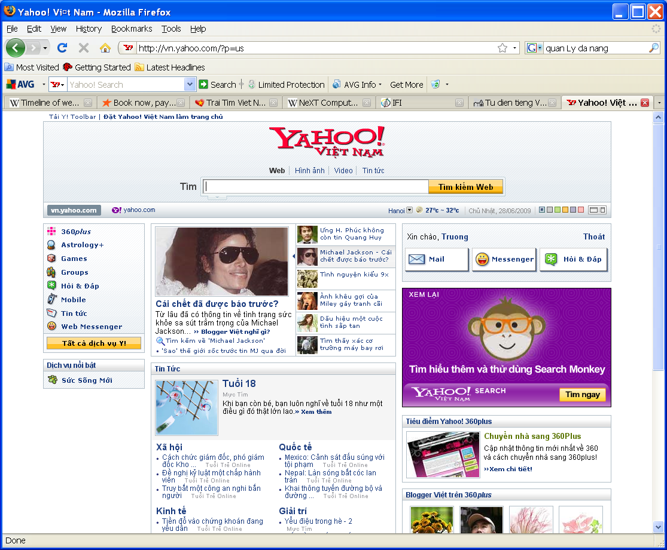
Typical applications
Social Network System

Slide 31
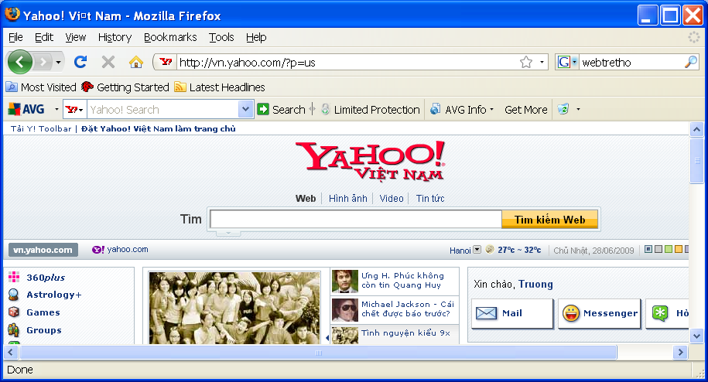
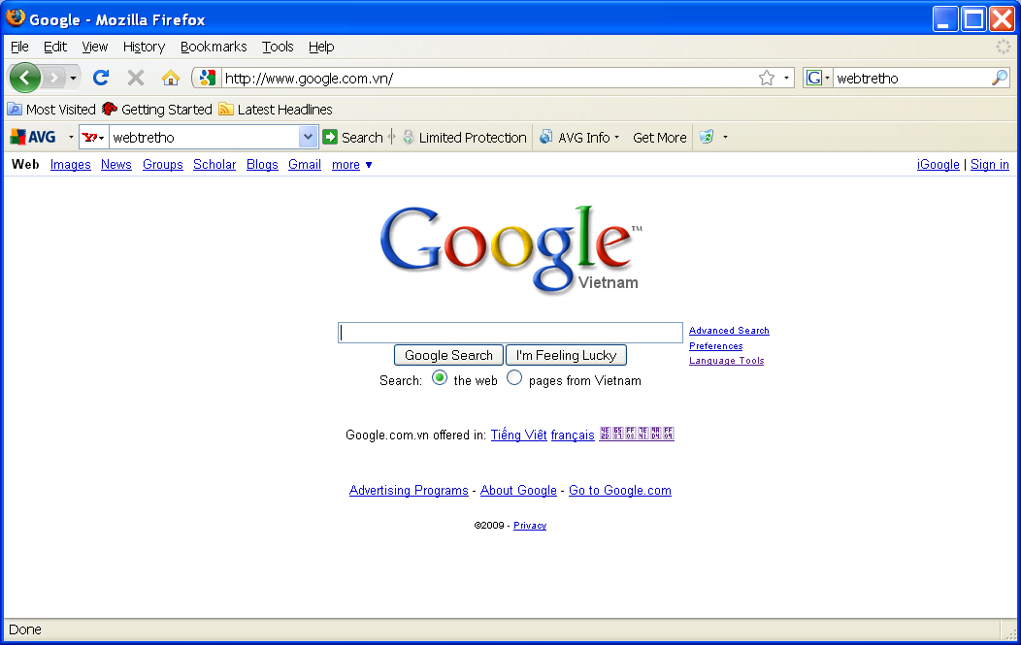
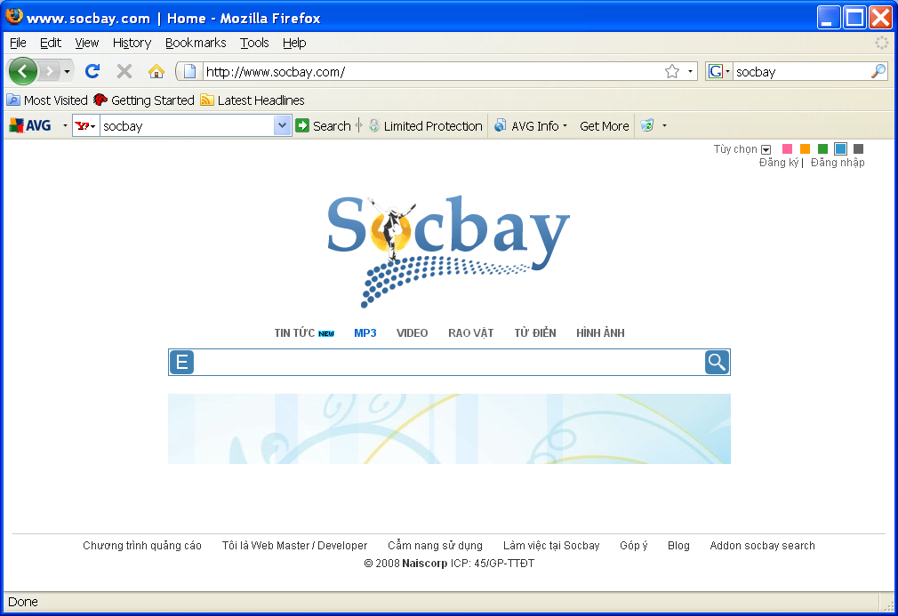
Typical applications
Search Engines

Slide 32
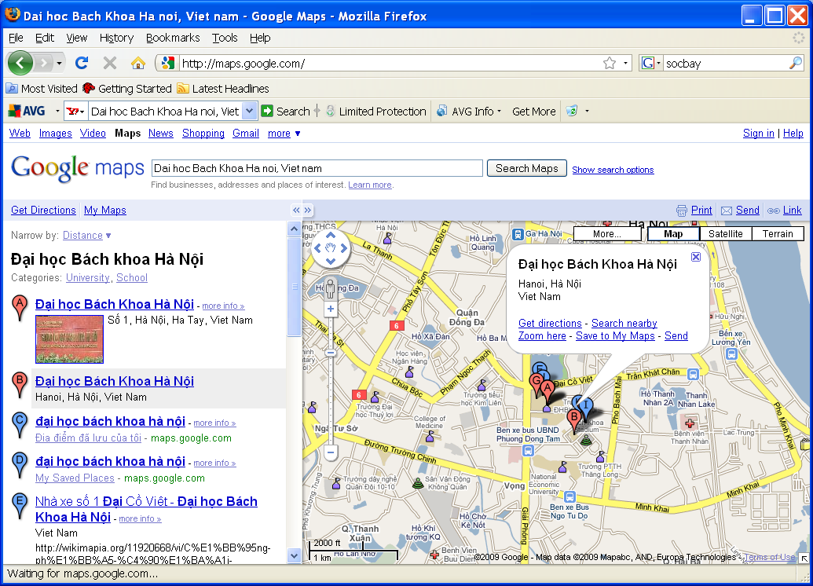
Typical applications
Google map

Slide 33
Social Impact
Advantages: Many things that you can do via the Internet
  E-mail: Instantly send and receive information from other peoples. Much faster in comparison with traditional mail by post office
  Access Information: Any kind of information on any topic under the sun is available on the Internet.
  Online Shopping: You do not need to leave your house for shopping.
  Online Chat: Meet new people, make new friends, as well as to stay in touch with old friends.
  Downloading Software: Many software, games, music, videos, movies, are available for downloading free or with fee on web.
Disadvantages
  Personal Information: Your personal information such as your name, address, etc. can be accessed by other people.
  Pornography: There are thousands of pornographic sites on the Internet that can be easily found and can be a detriment to letting children use the Internet.
  Spamming: hundreds of spam email per days per user accounts.
  Virus threat

Slide 34
Classification of Web Information System
How a web information system can be useful?
Why we build a web information system? What for?
Classification according to user interaction
  From user to WIS
  From user to user by using WIS
  From user to WIS by using another WIS

Slide 35
Classification of WIS
According to application domain
  News website: managing and publishing news
  Social network
  Management system: online store
  Transport mean for distributed system: webservices
  Operating system: Web operating system
    web is used for accessing remote resource
    Google apps

